Slide 1
Animal Magic
Practice management app for vets - Peter Mordaunt

Slide 2
Brief
A veterinary practice has approached you to build a web application to help them manage their animals and vets.
Vets look after MANY animals
Animals have a SINGLE vet
Owners can have MANY animals
Animals have a SINGLE owner
Animals & Vets can have MANY appointments

Slide 3
Brief - Functionality
Be able to assign or register Pets with Vets
CREATE – Pets, Vets, Owners & Appointments
READ – Vet, Pet & Owner records, Appointment details and notes.
UPDATE – Owners & Pet records, Vet Details, Appointment Notes
DELETE – Pets or Vets that leave the practice.

Slide 4

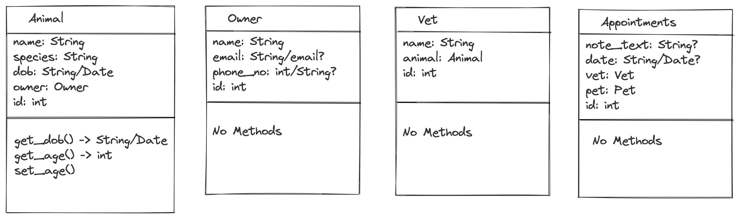
Planning
Class Diagrams

Slide 5
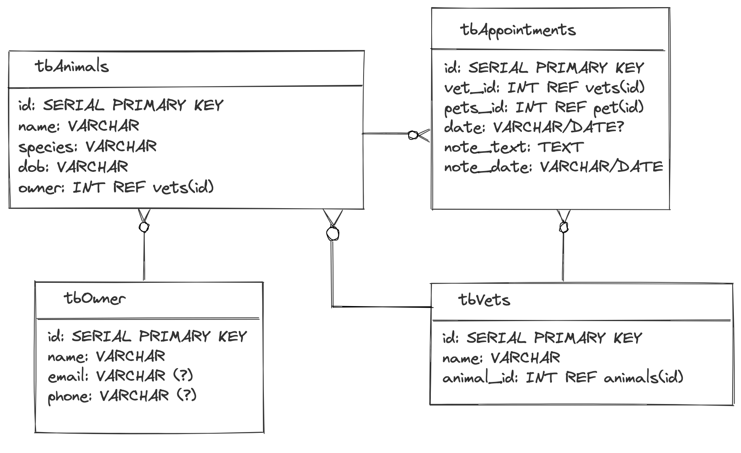
DB
Table
Diagrams

Slide 6
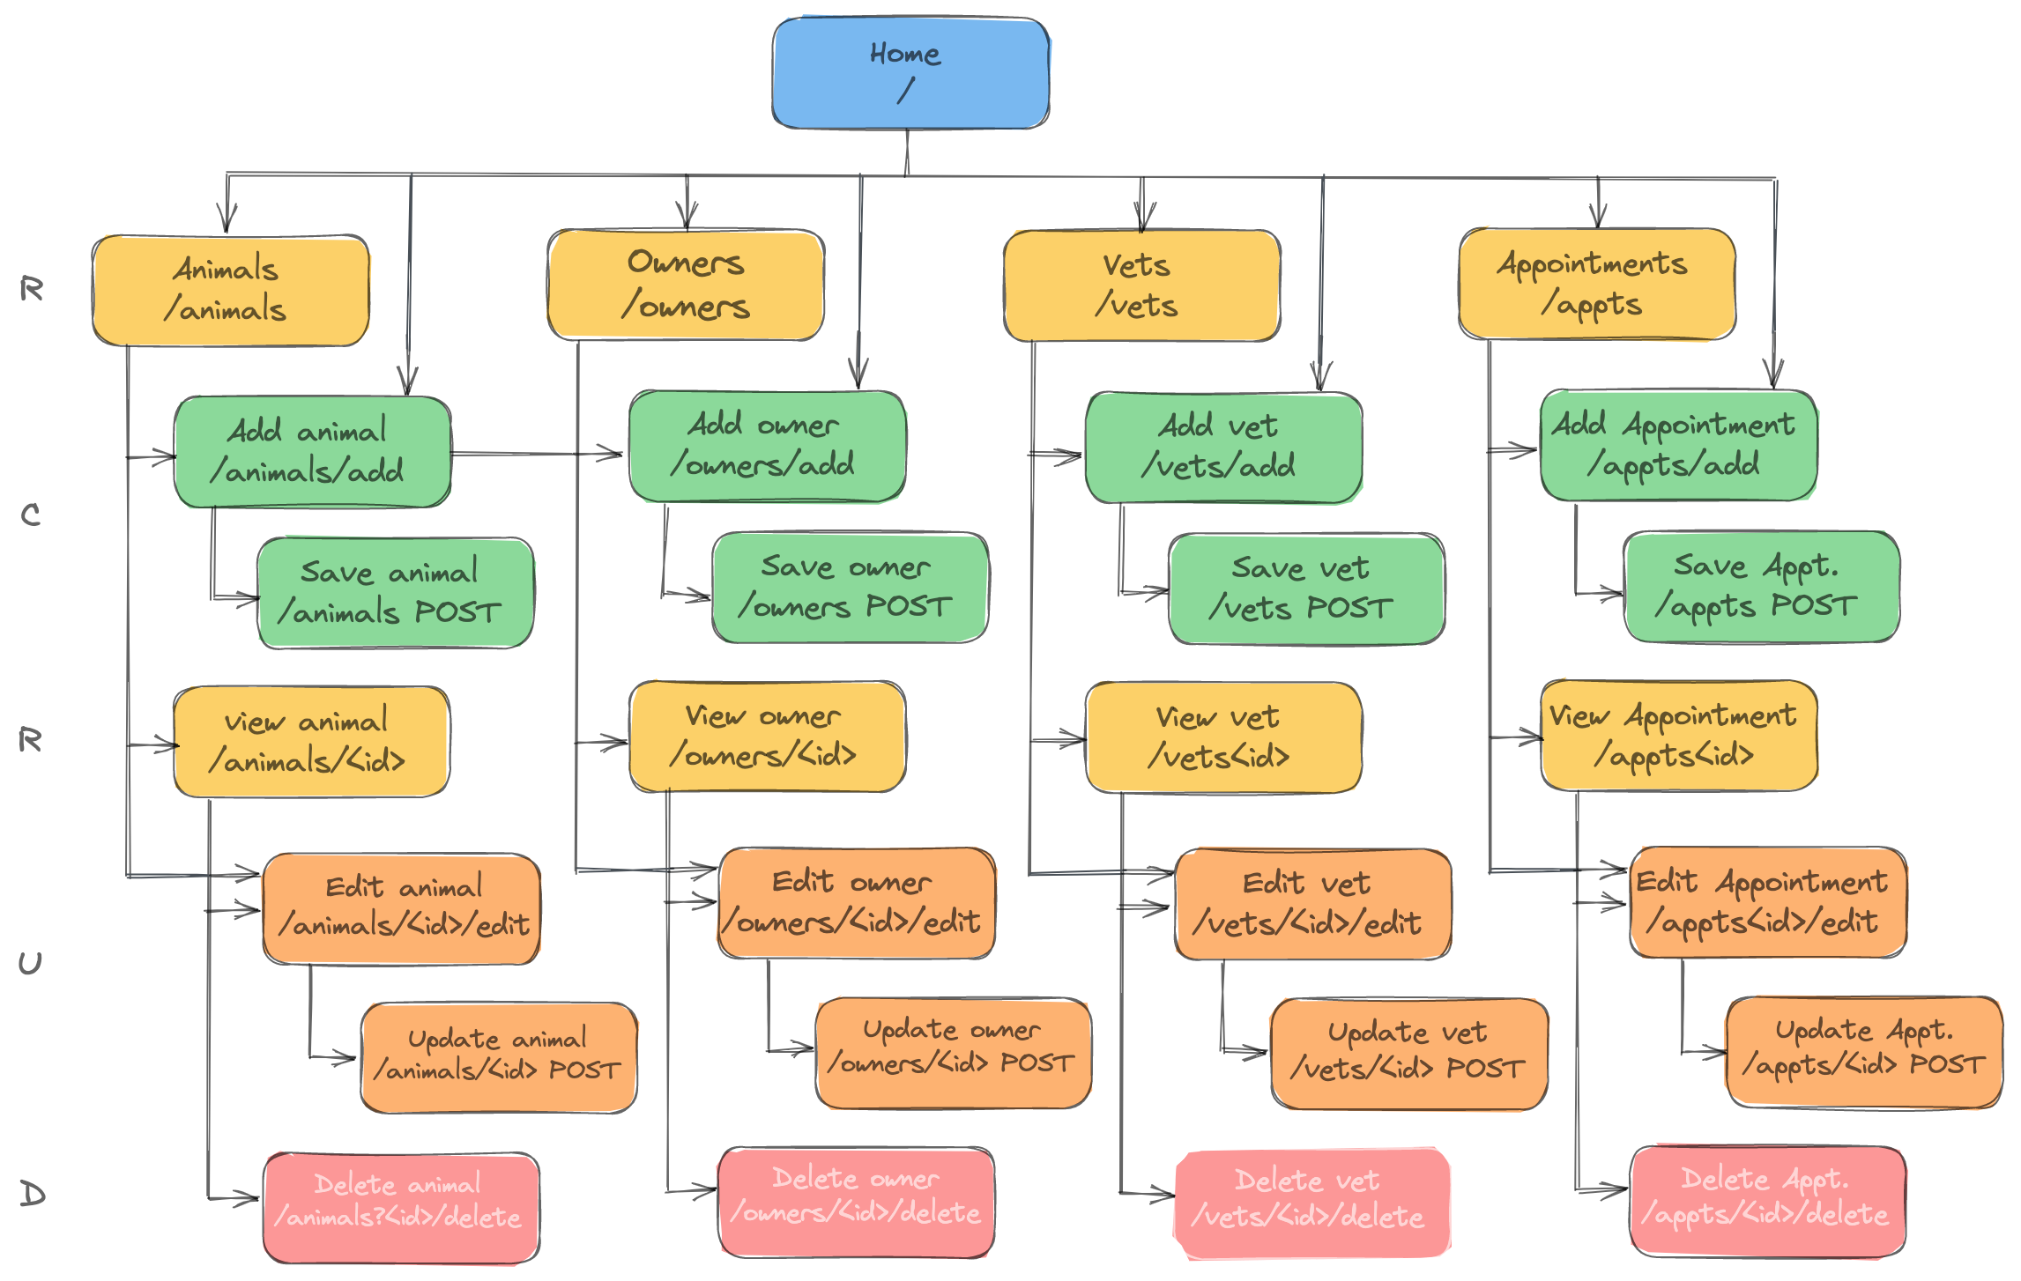
Site
Map

Slide 7
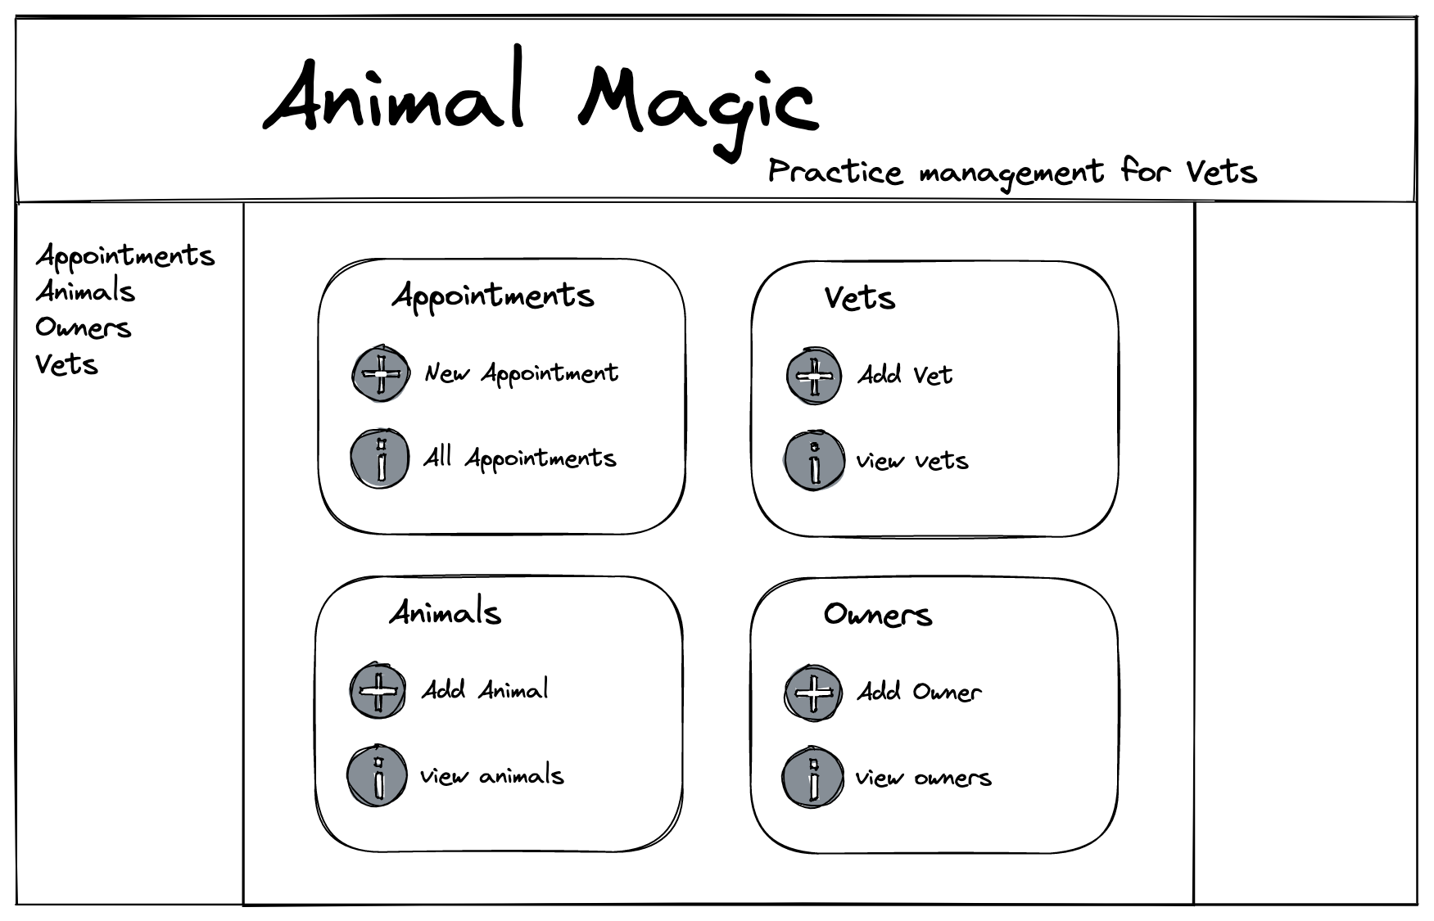
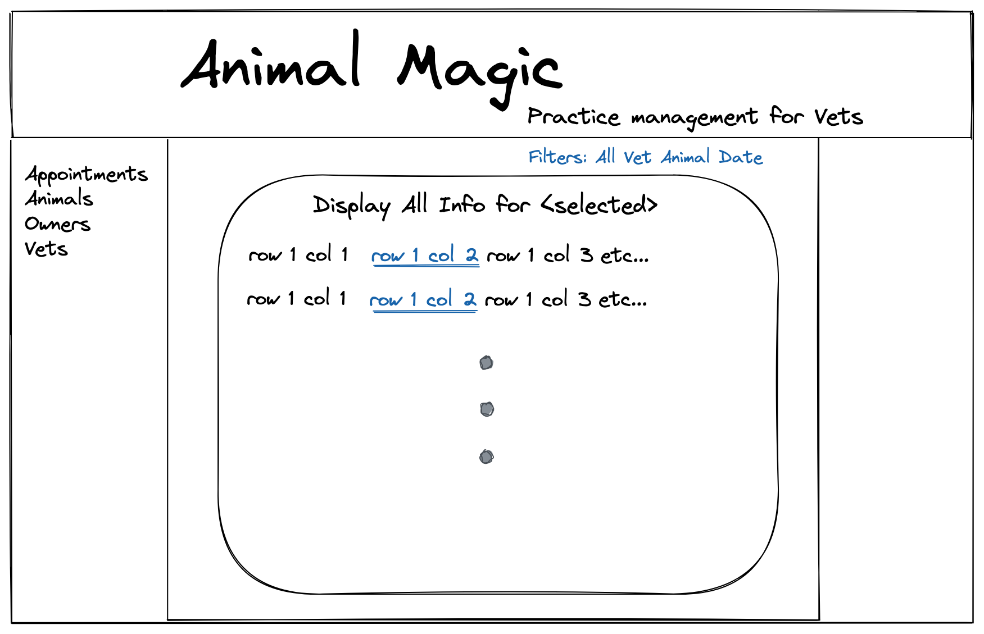
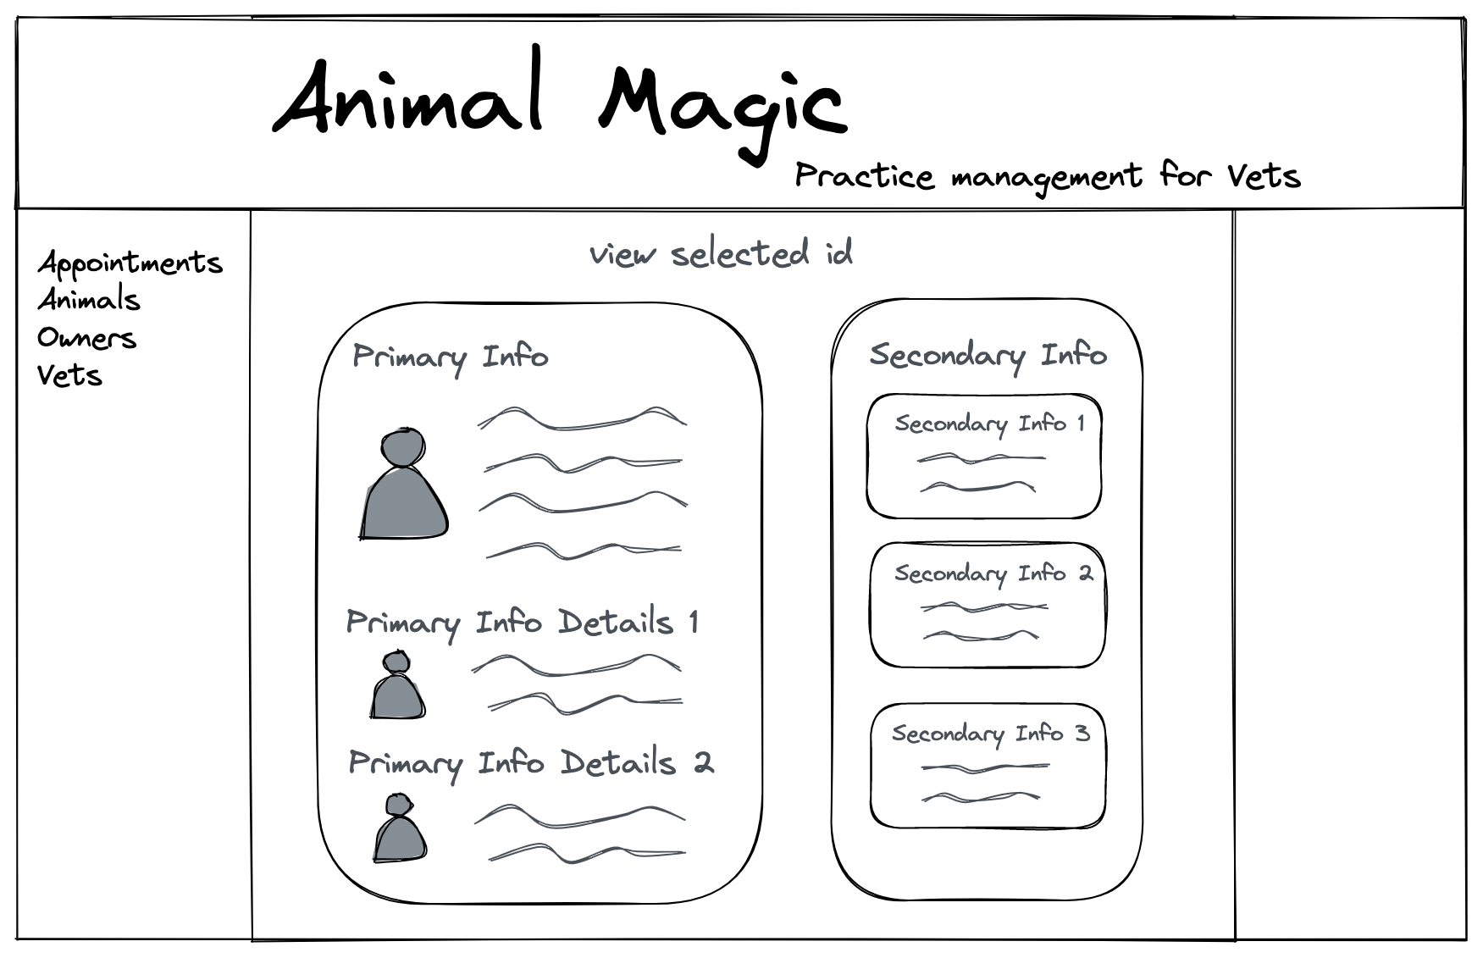
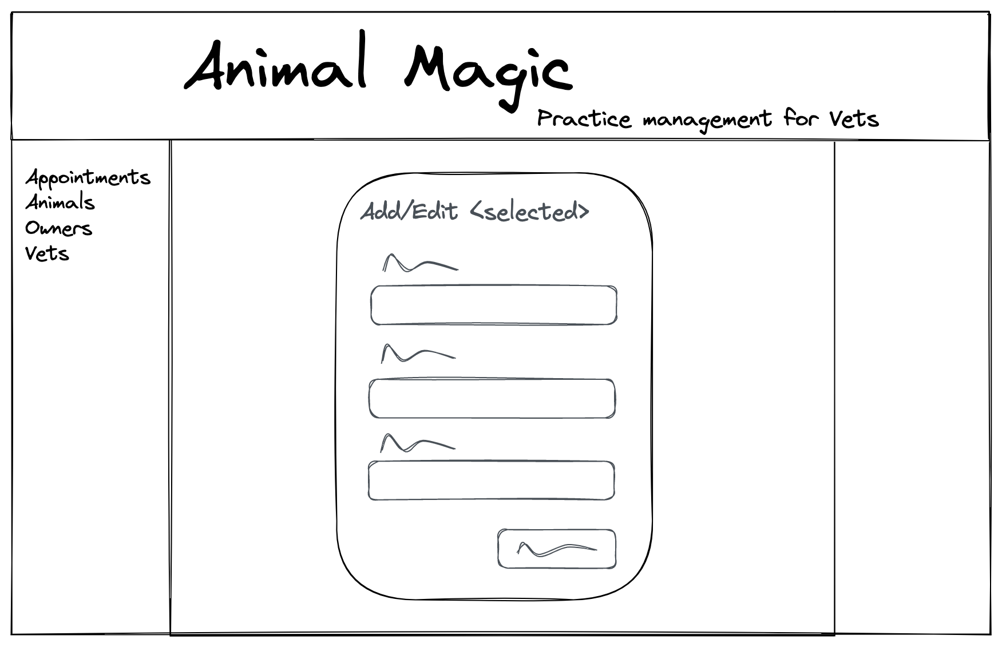
Wireframes

Slide 8
Extension Ideas
Must, should, could, won’t
Add warning message for deleting (should)
Set vet for making appts so not editable(should)
Add confirm message for updates (Should)
animal.get_all_appointments() (for vet too, maybe even owners for all animals) (should)
Age or dob option? (should) could solve with dummy dob based on reg date & dob known bool
Add all appointments in aside on view animal page (should)
Make all fields required when adding new entries(should)
Filter by date, animal, vet, owner (should)
Add submenu items – add/edit/all (should)
Add short note with option to expand (could)
Filter by in clinic – handle check in/out (could)
Check if owner exists when add new owner (could)
Media queries – collapsible menus etc (could)
Login page – different views for user type, ie Vet or Reception (could)
Billing? (Could)
Online booking (won’t)

Slide 9
Learning Objectives
Using SQL
Working with Routes
Understanding how they integrate and getting it clearer in my head!
Experiment with CSS & HTML

Slide 10
Many to Many Inner Join statement
"SELECT appointments.appt_date, appointments.note_text, animals.name, vets.name, appointments.id
FROM appointments
INNER JOIN animals ON animals.id = appointments.animal_id
INNER JOIN vets ON vets.id = appointments.vet_id WHERE vets.id = %s”
OR
SELECT * FROM appointments WHERE vet_id = 9 + a bit of python

